Slide 1
Eco Conference 18th June
‘What’s so good about trees?’
John Tucker

Slide 2
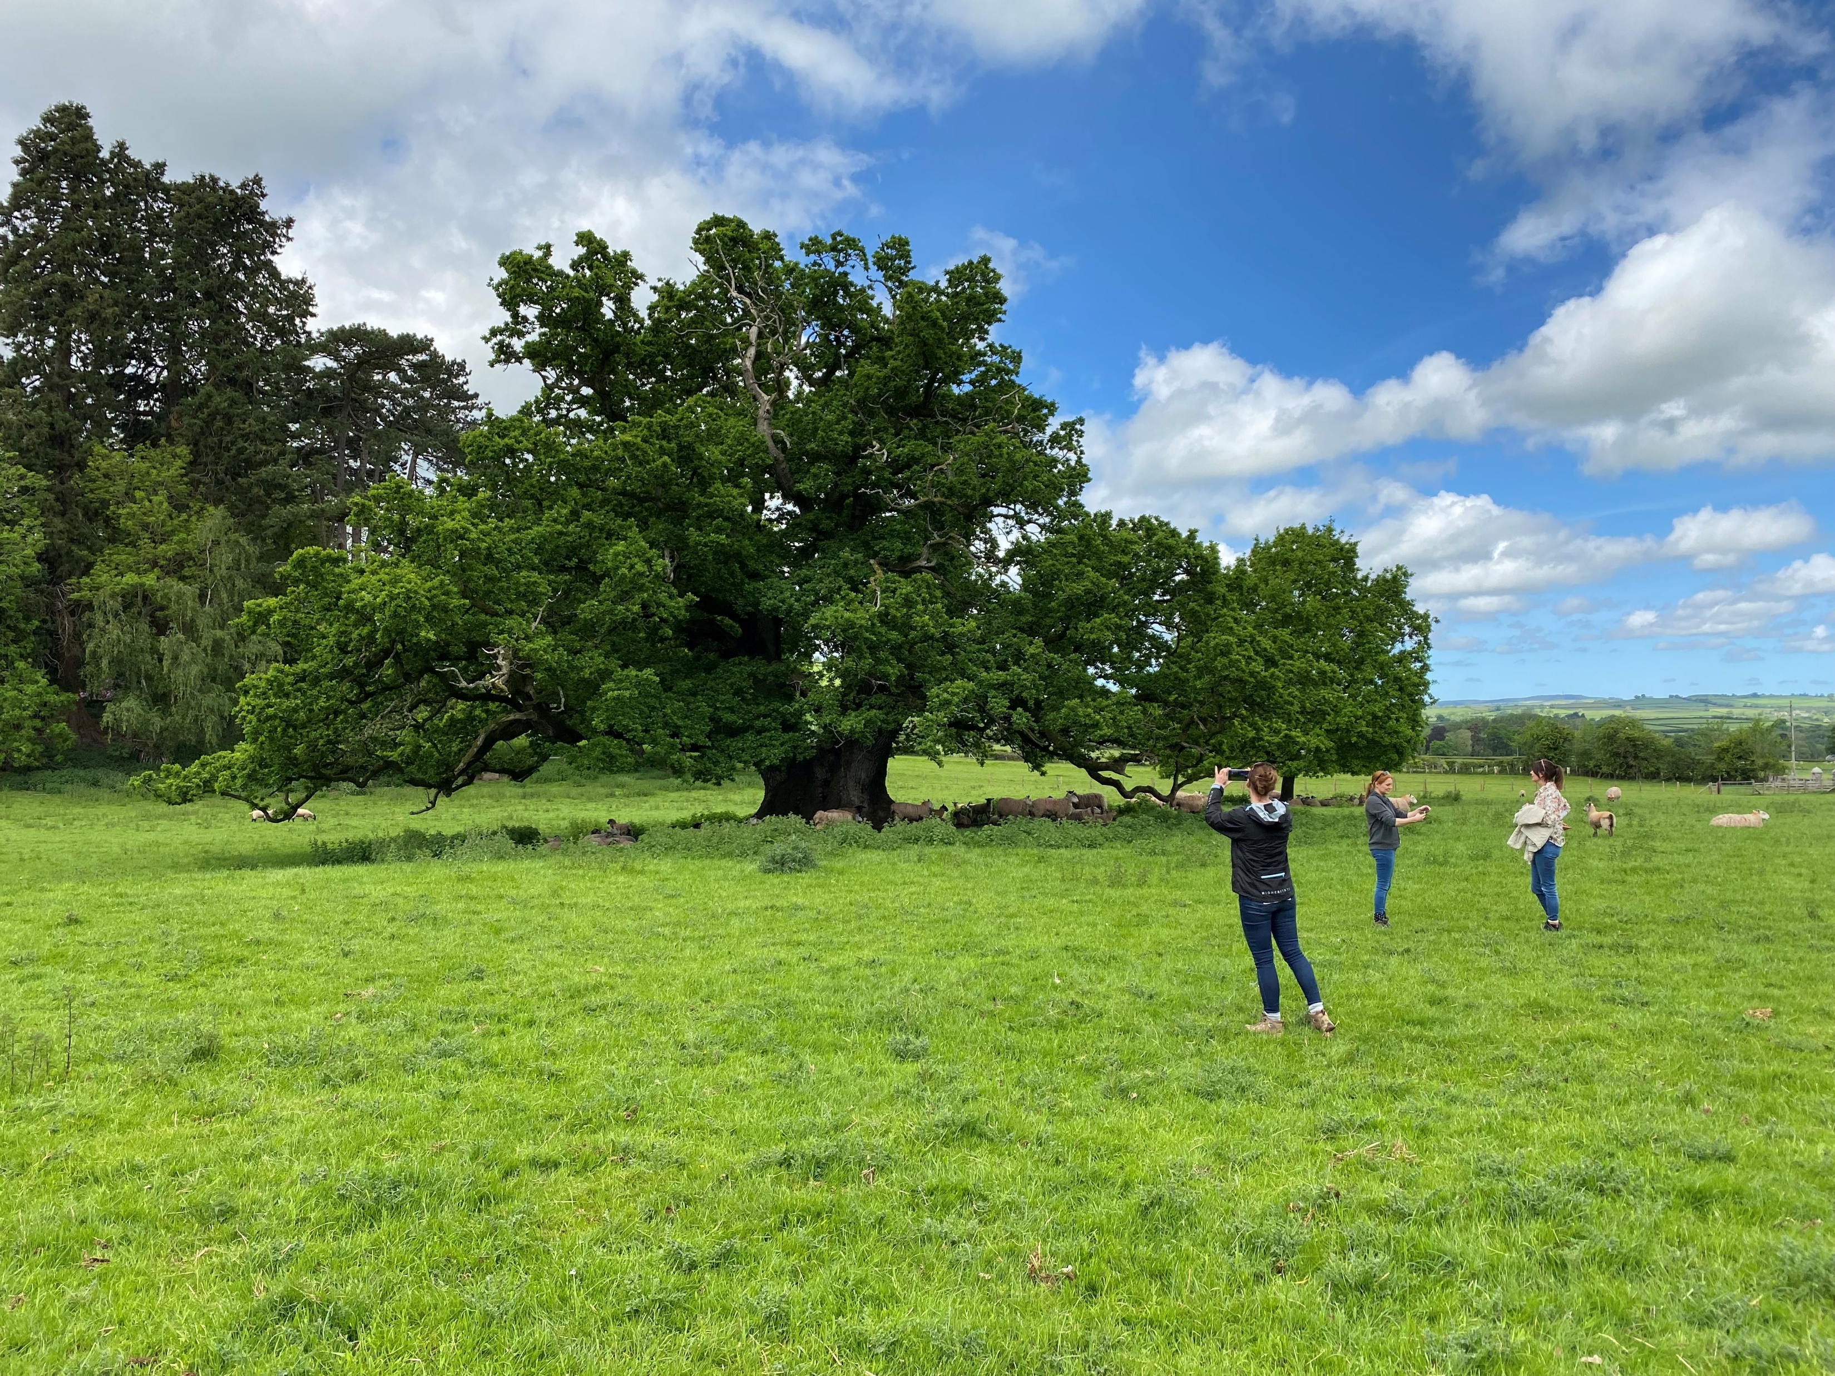
What am I going to talk about?
What are the environmental problems that we face?
What can trees do to help?
What can we do to help?
Notes:
Pentref oak near brecon

Slide 3
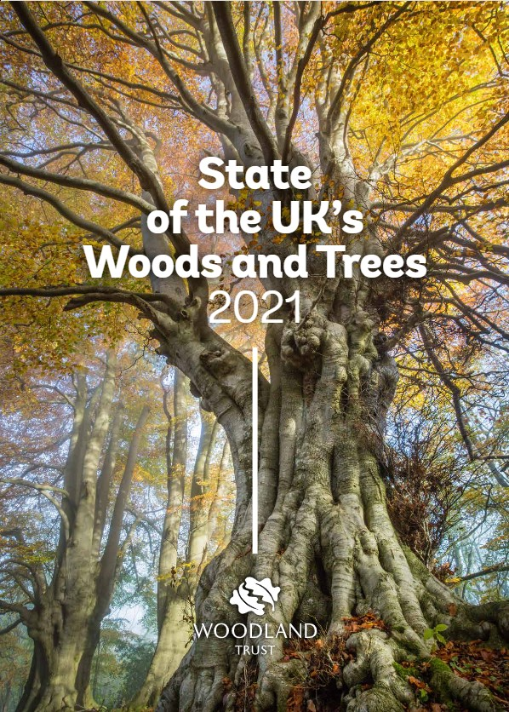
Nature Crisis
Only 7% of native woodlands are in good ecological condition
Woodland birds have declined by 29% since 1970
Woodland butterflies have declined by 41% since 1990
Woodland plants have declined by 18% since 2015.
Notes:
Report findings – we need to protect and enhance our remaining woodland and expand tree and woodland cover.

Slide 4
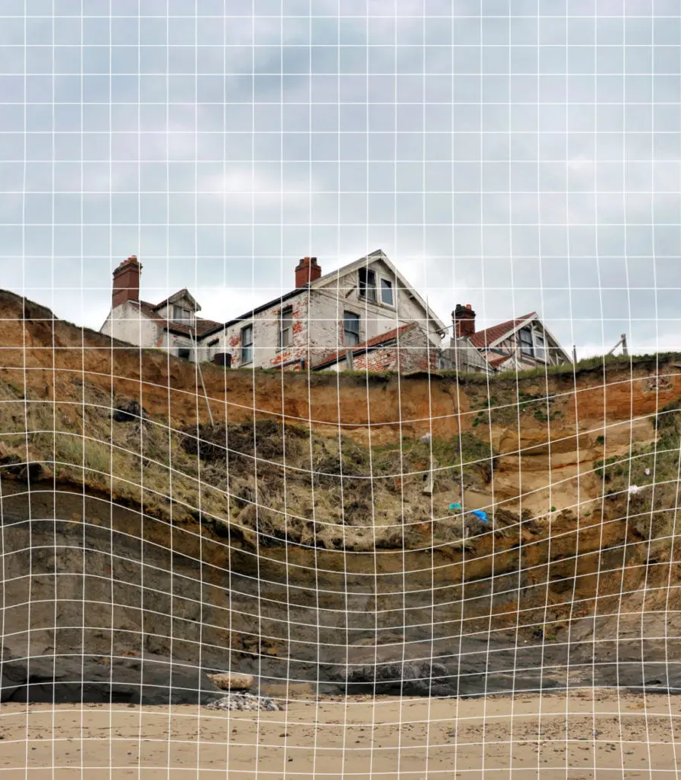
Climate Crisis
3rd Independent Assessment of UK Climate Risk (June 2021)
‘By 2050 the heatwave summer of 2018 will be a typical summer, summer rainfall could fall by as much as 24% and winter rainfall increase by as much as 16%, changes that will impact our well-being, the natural environment and the economy.’

Slide 5
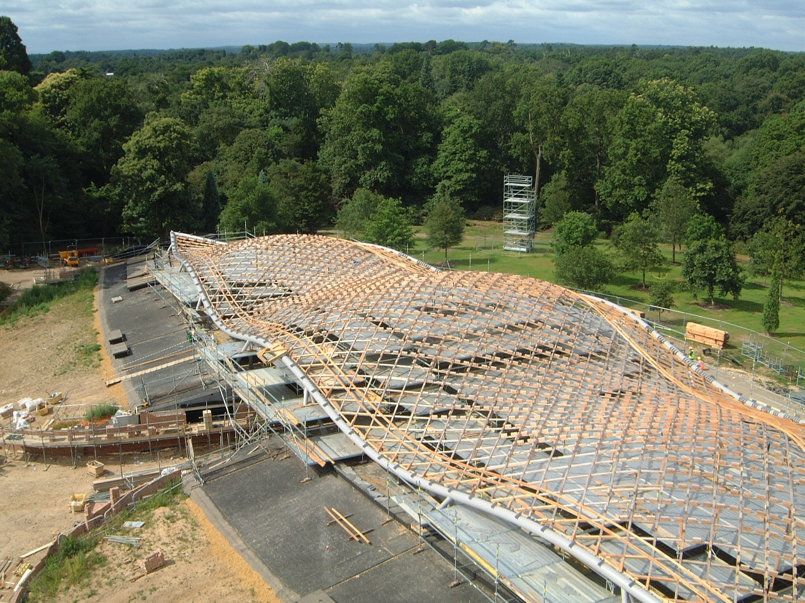
Food security+ timber security
Notes:
2nd biggest timber importer in the world, import over 80% of all the timber we use.

Slide 6
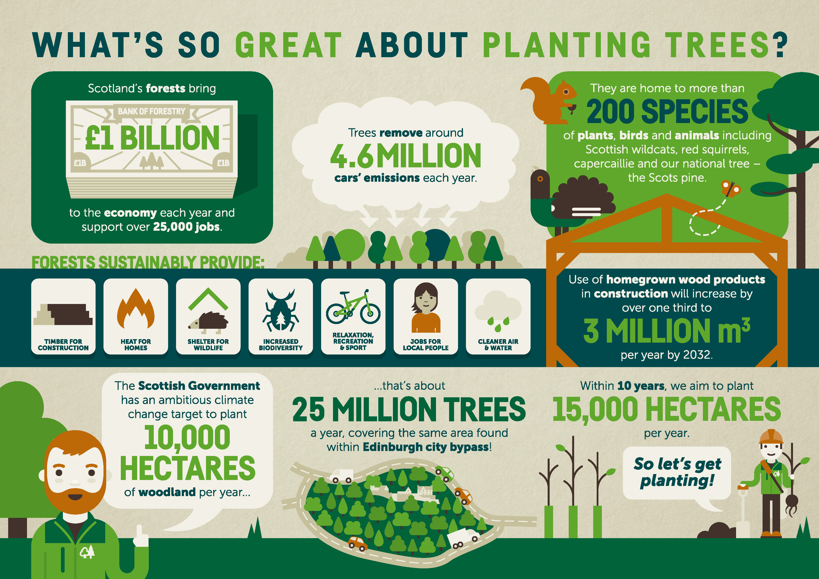
What can trees do to help?

Slide 7
Scale of the challenge
Climate Change Committee – 30,00ha annually of new woodland up to 2050.
Increase UK woodland cover from 13% - 19%
2019 – 13,400ha created, highest level since 2003.
We have only created in excess of 30,000ha annually once since 1976.
The challenge is enormous.

Slide 8

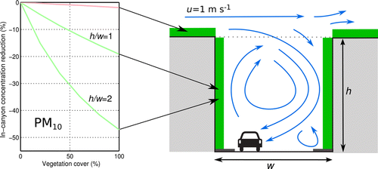
Impacts on air quality
Pugh et al 2012 showed how “vegetation” could be an efficient remover of both PM and NO2.
Notes:
Remember down side asthma and birch
Heat island effect, increases ground level ozone, respiratory problems
Ridged hairy leaves are best birch and alder

Slide 9
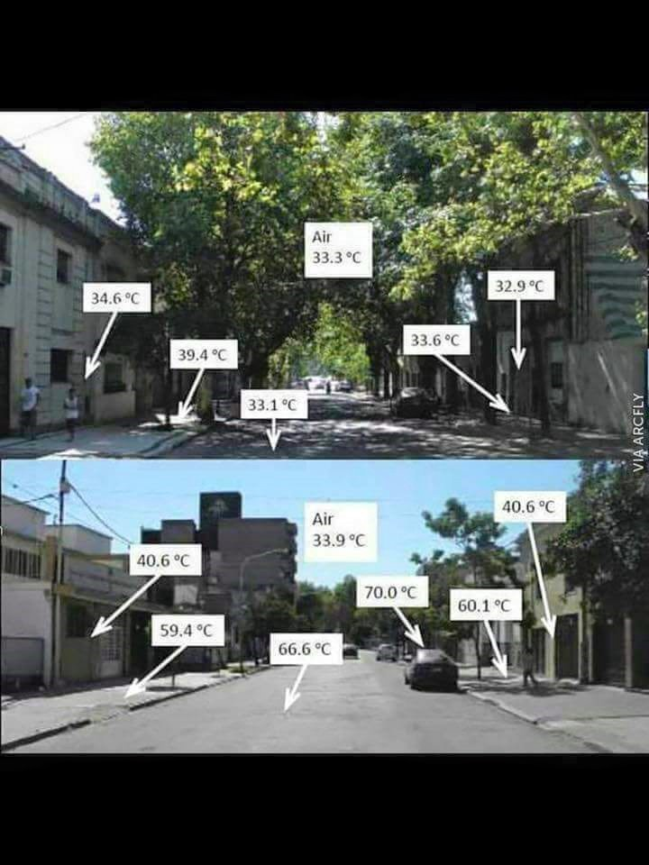
Sha
The shade value of trees will be important as the climate warms. This is an example from Nigeria.

Slide 10
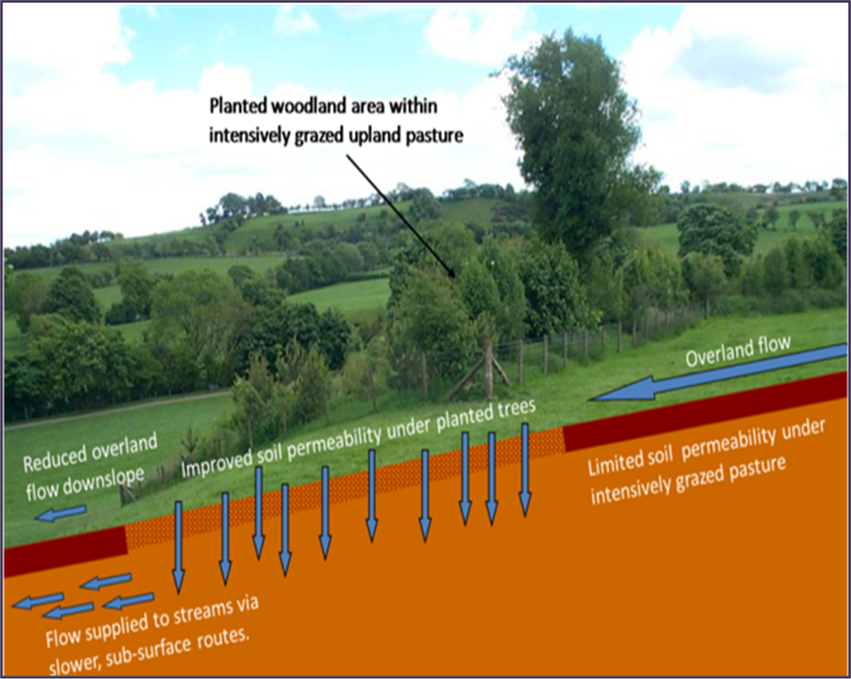
Notes:
Lose 2.9m tonnes topsoil annually
Poor quality soil, impacts of roots on soil structure, quality and run off

Slide 11
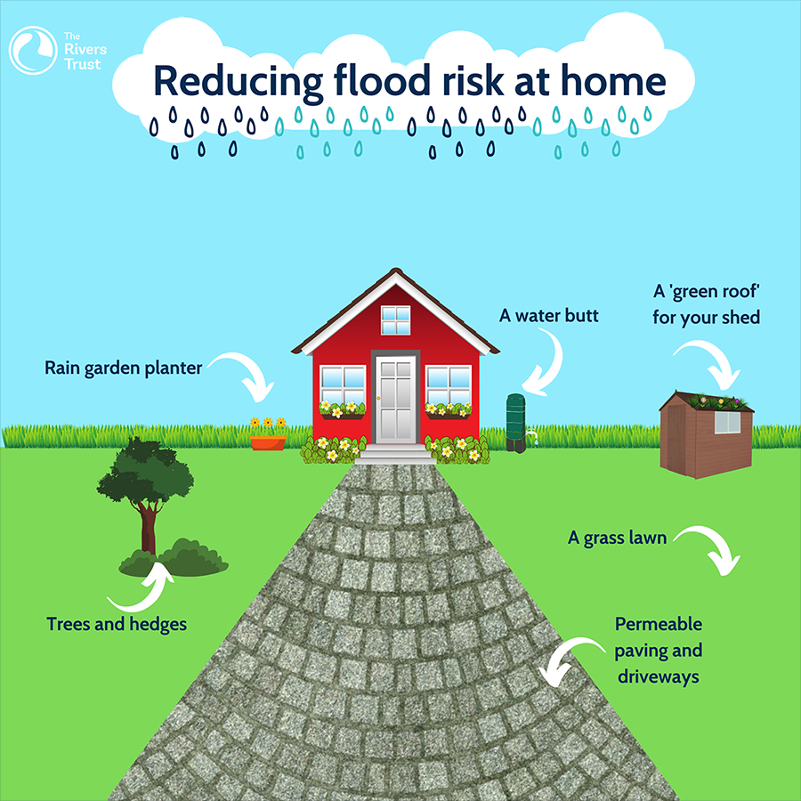
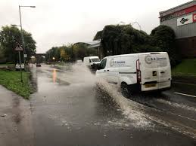
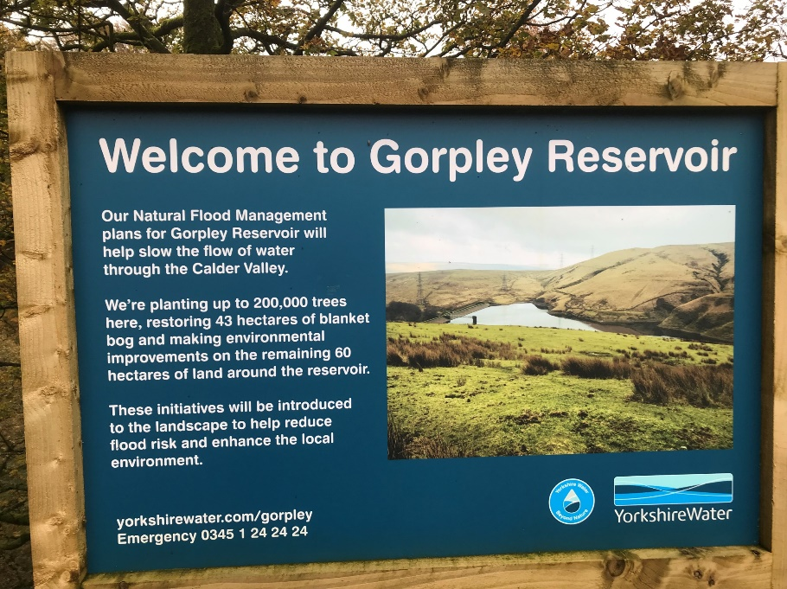
Notes:
Not just rural problem

Slide 12
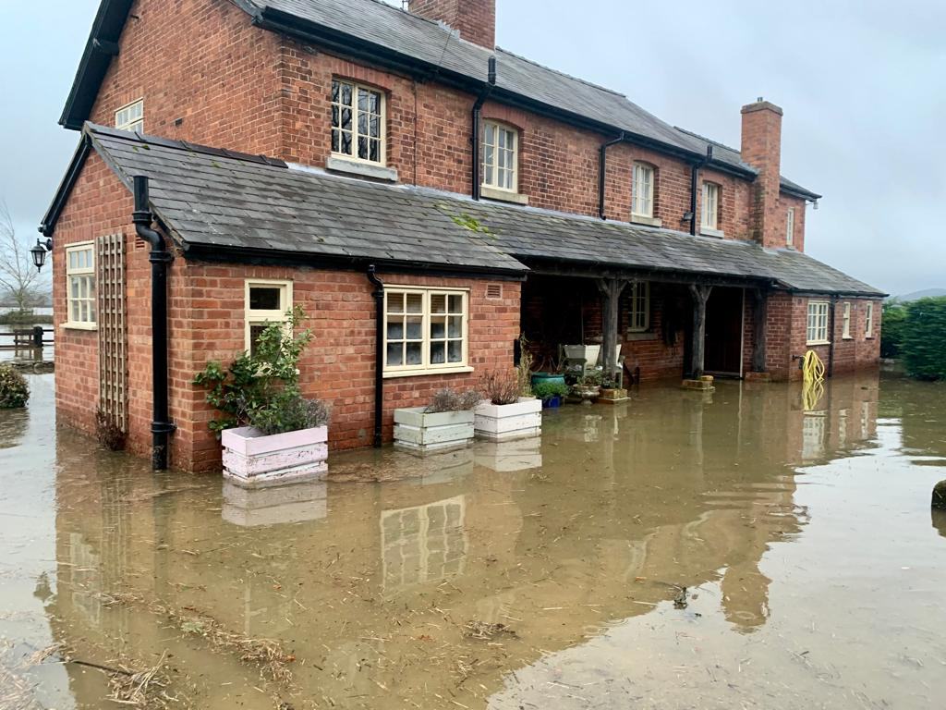
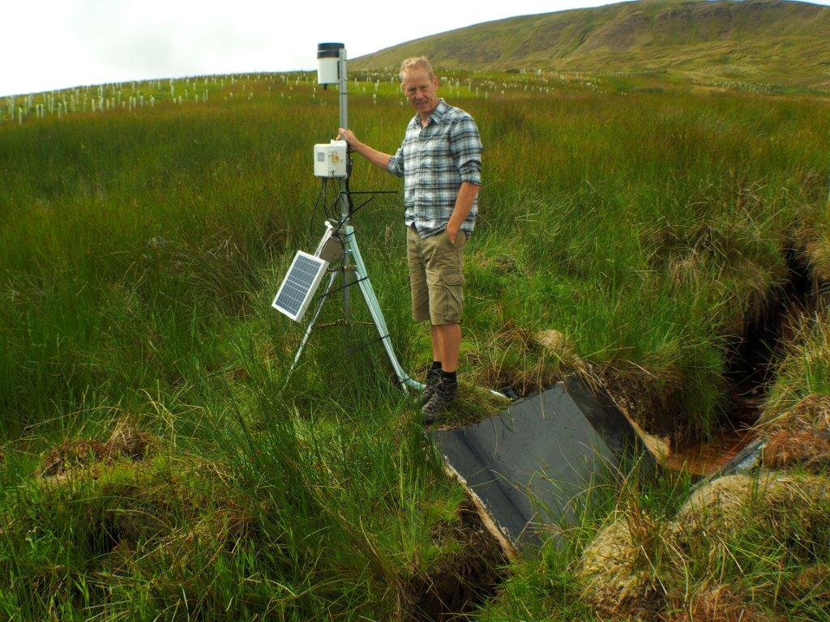
Trees and flooding
Notes:
Harriet – Shrewsbury
Lancaster university water flow impact

Slide 13
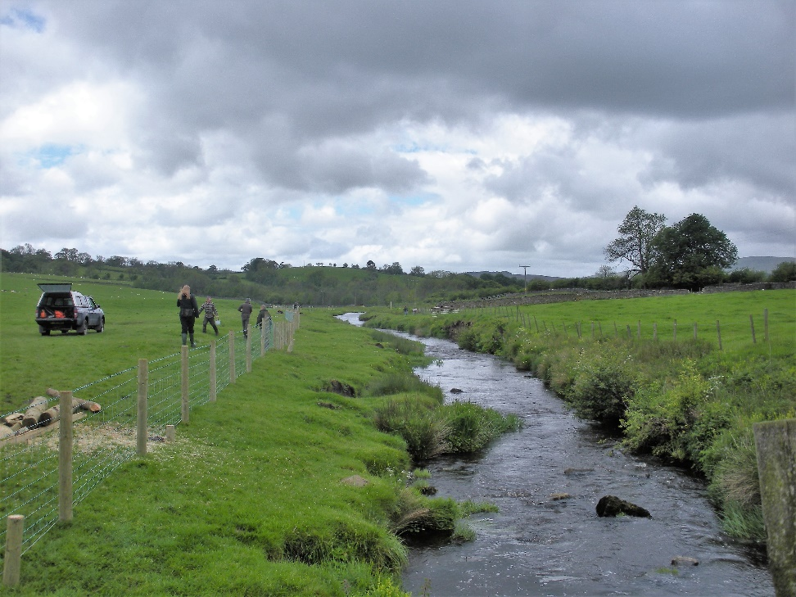
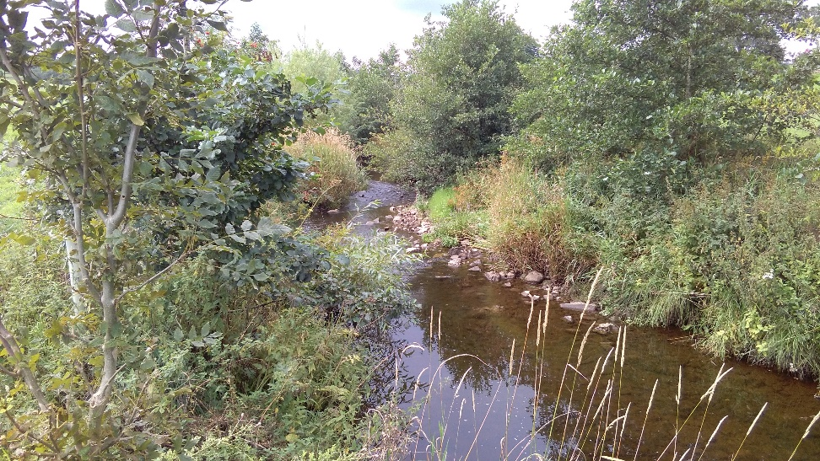
Small scale riparian planting to protect and shade water courses and improve water quality.
Notes:
Forest of Bowland 8 years apart. Intensive dairy farm and problems with nitrate run off. Important salmon area.

Slide 14
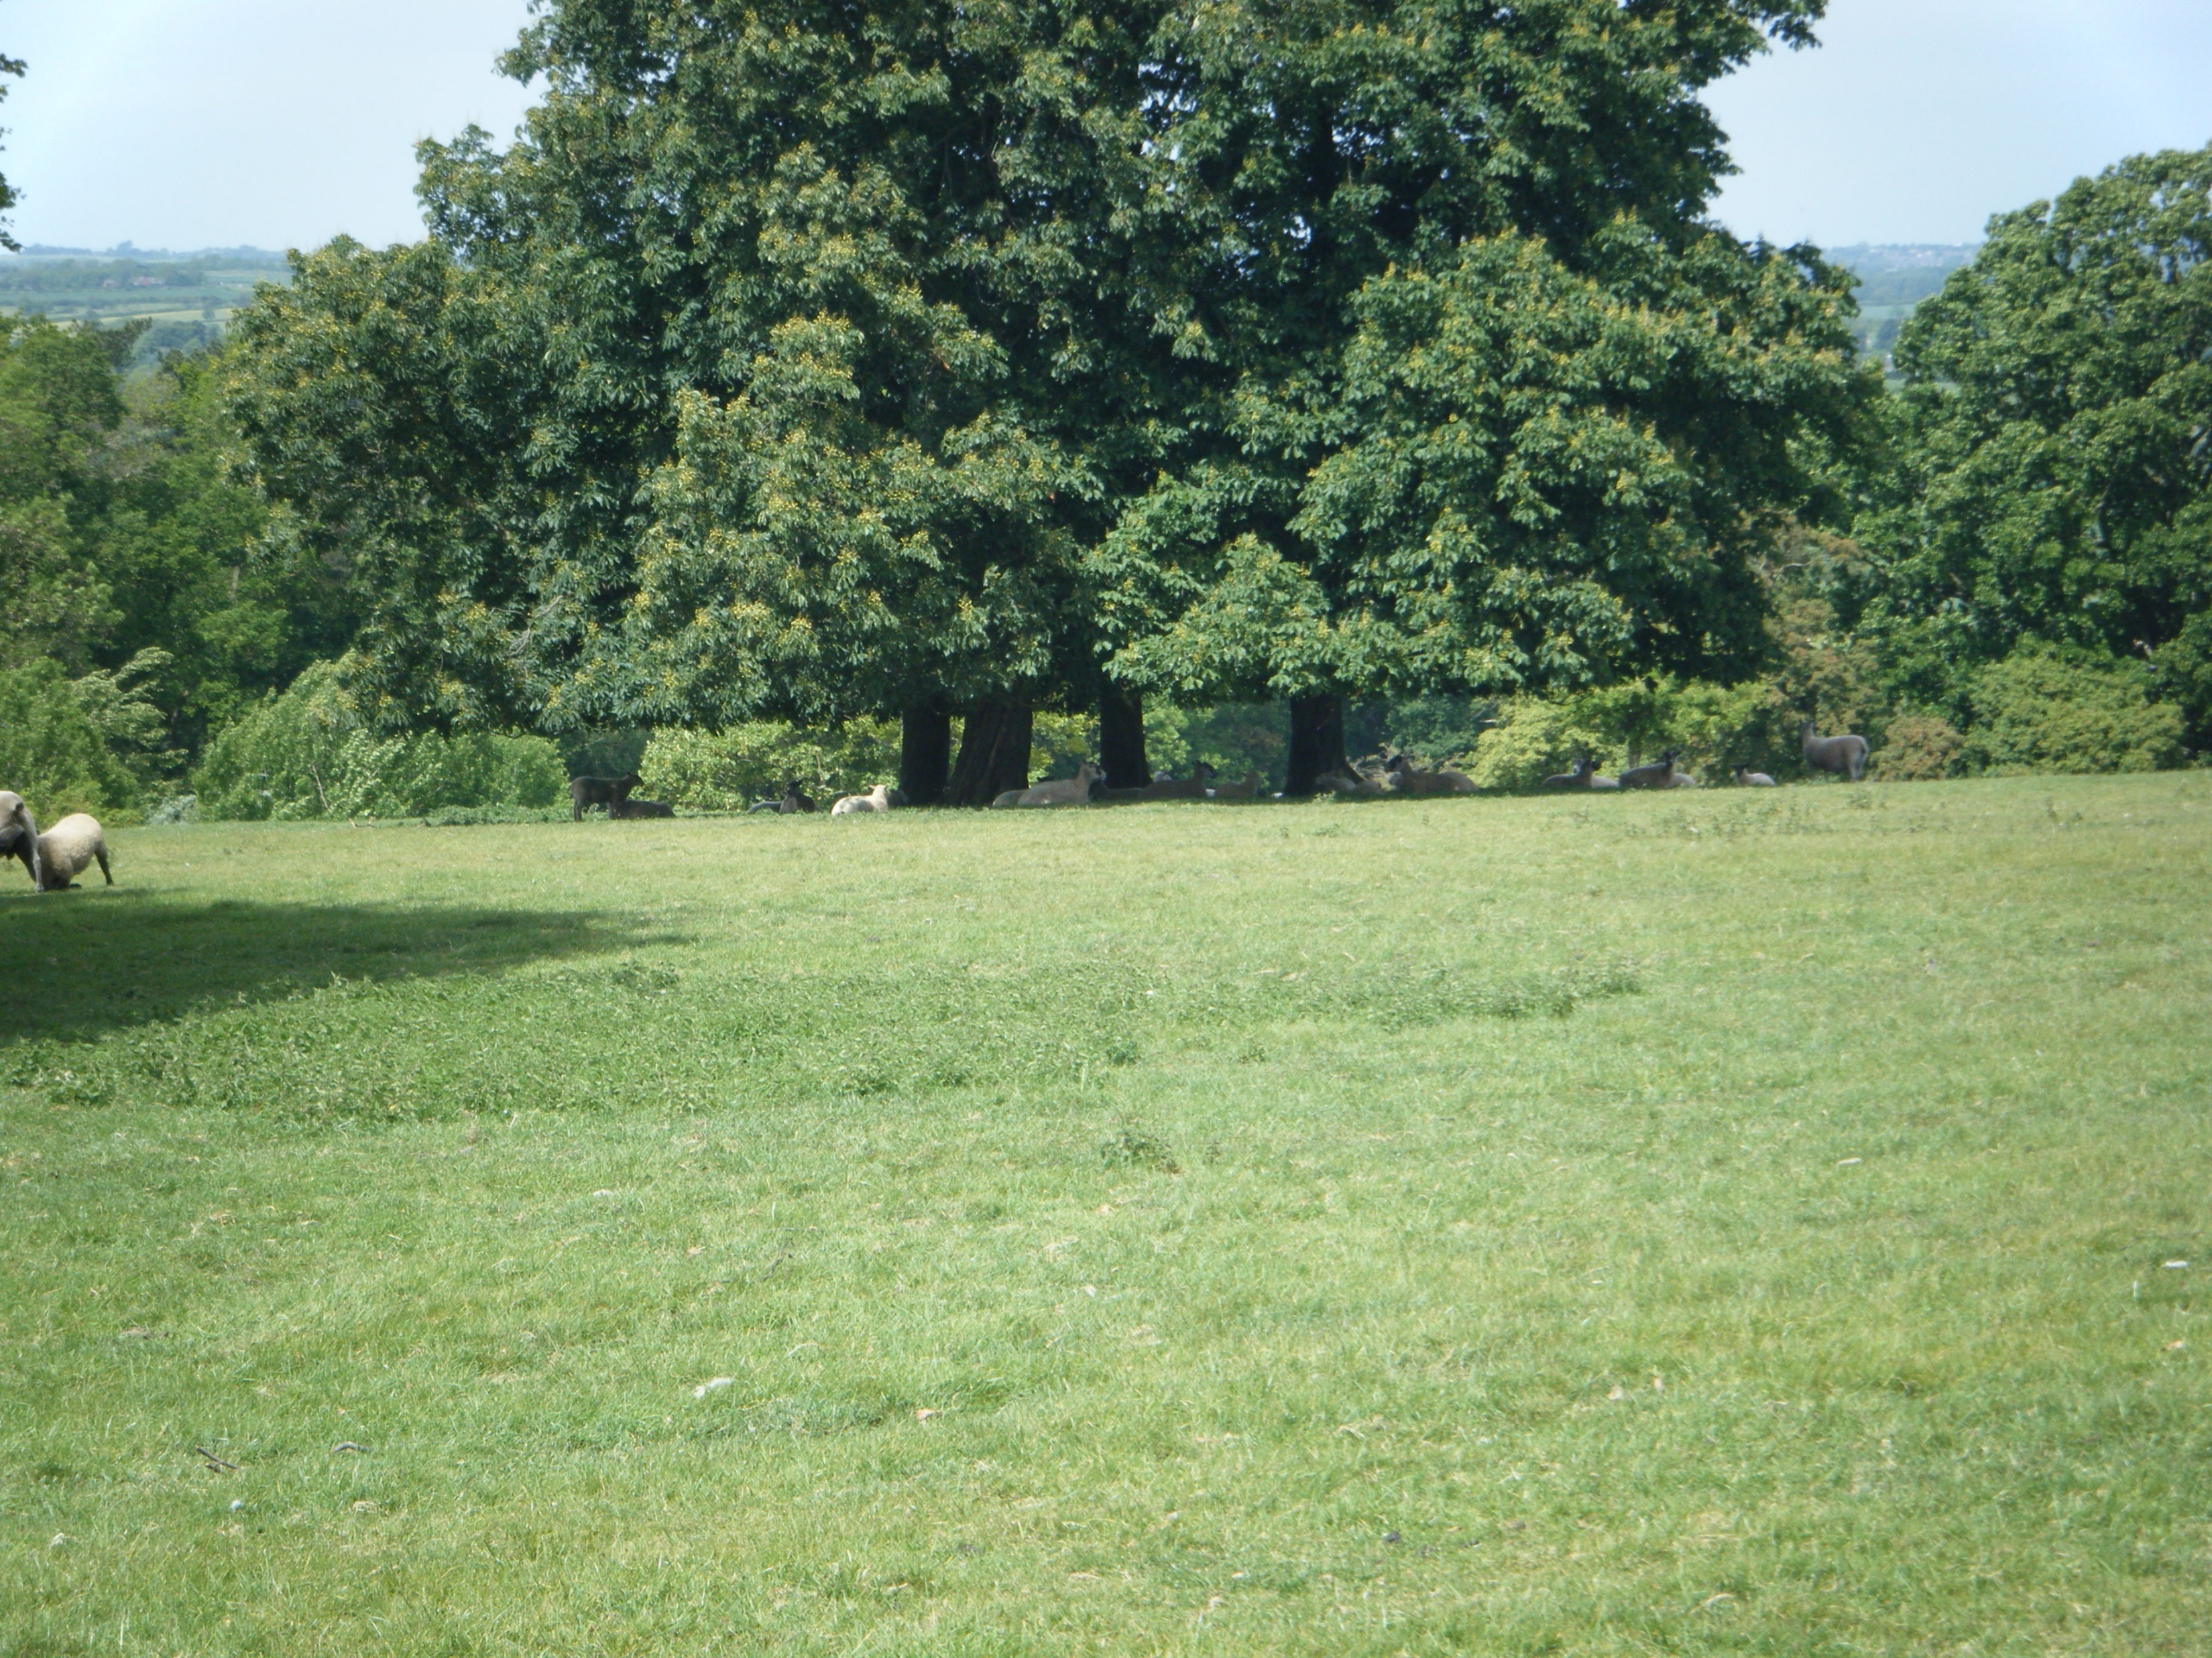
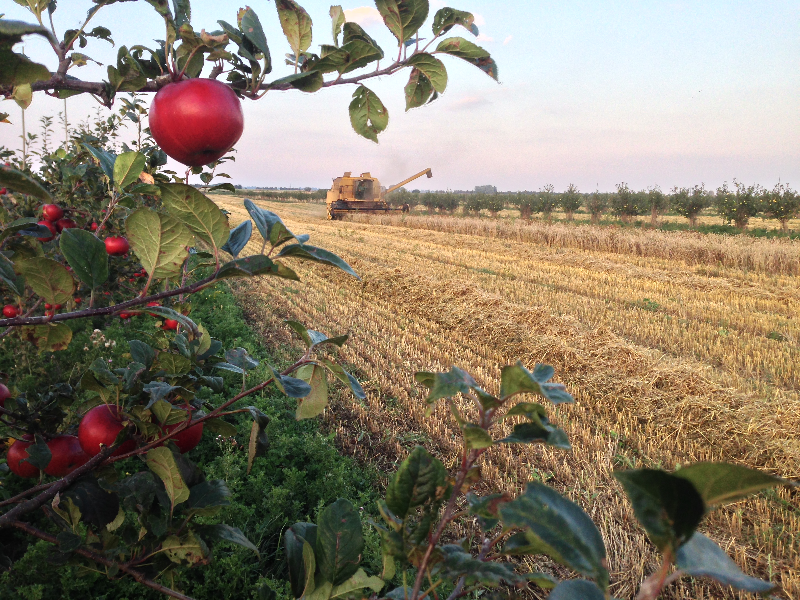
Trees working for farming
Notes:
Value of shade, value for diversification and other crops

Slide 15
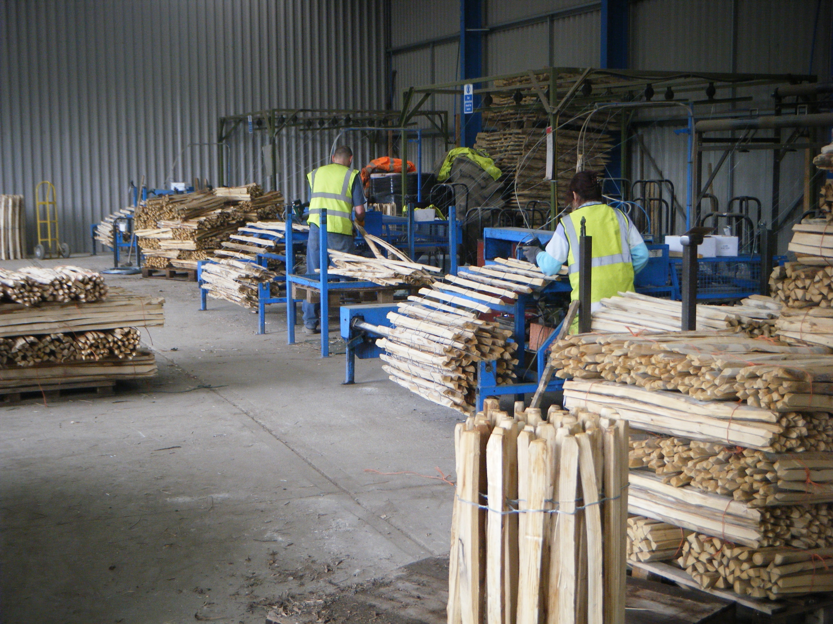
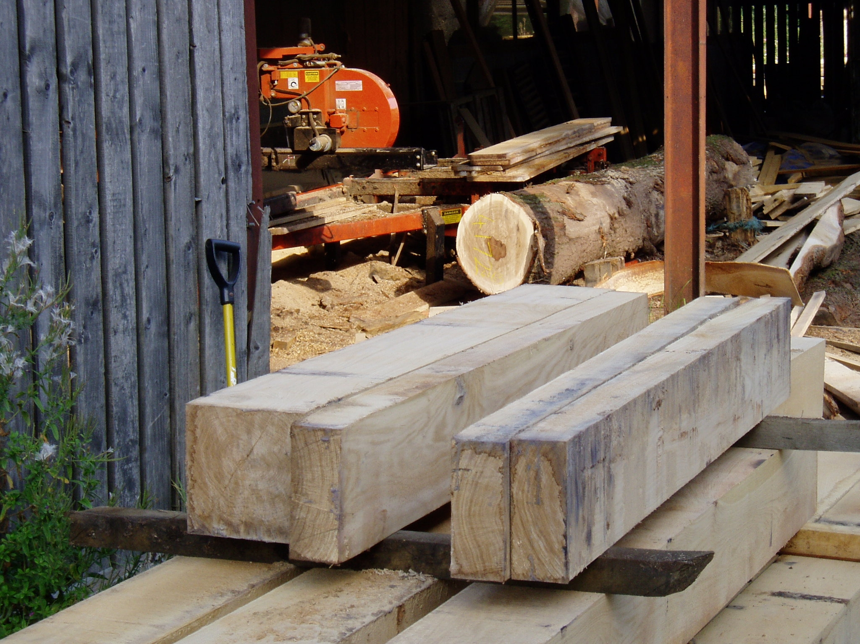
Timber

Slide 16
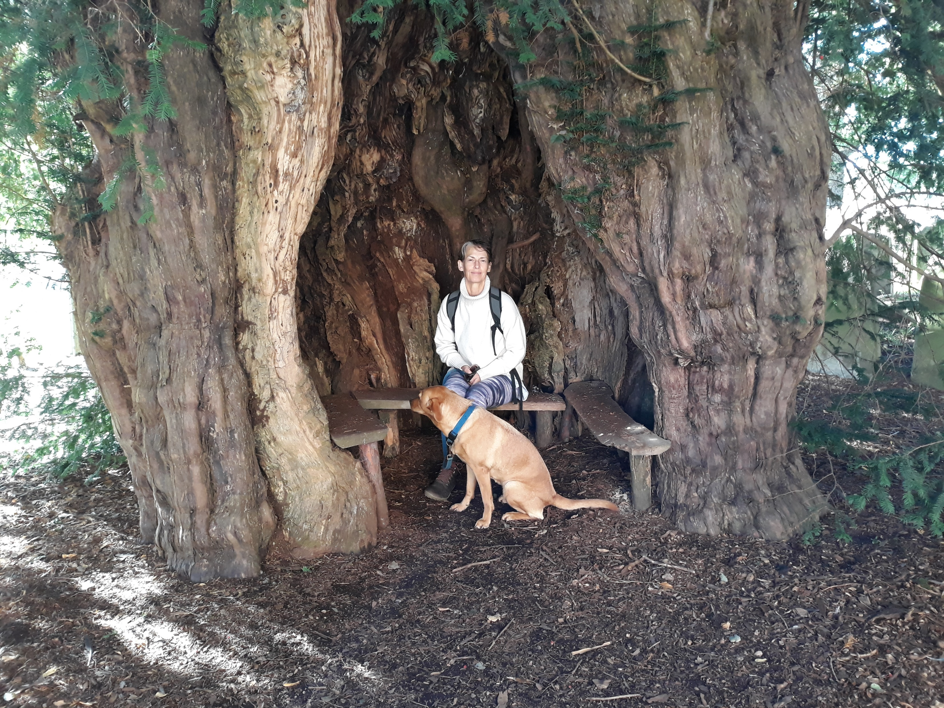
What can we do?
Notes:
Much Markle yew Herefordshire, around 1500 years old. Church yards are great for ancient trees, start recording them

Slide 17
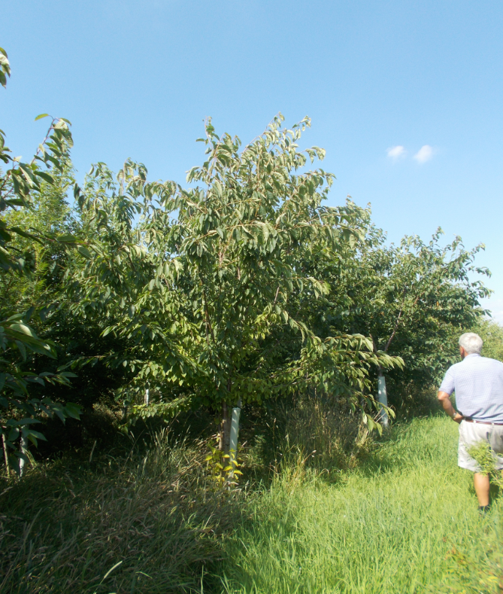
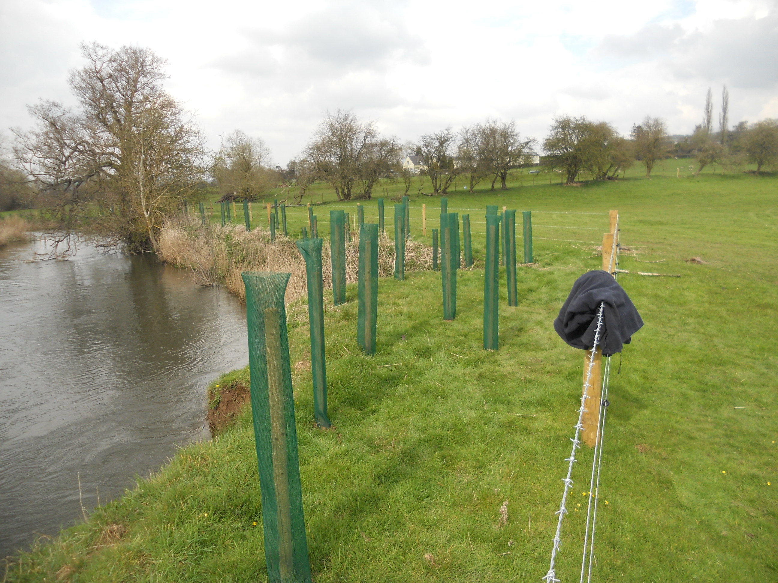
Plant new woodland- MOREwoods scheme
Notes:
3,300ha planted since 2011

Slide 18
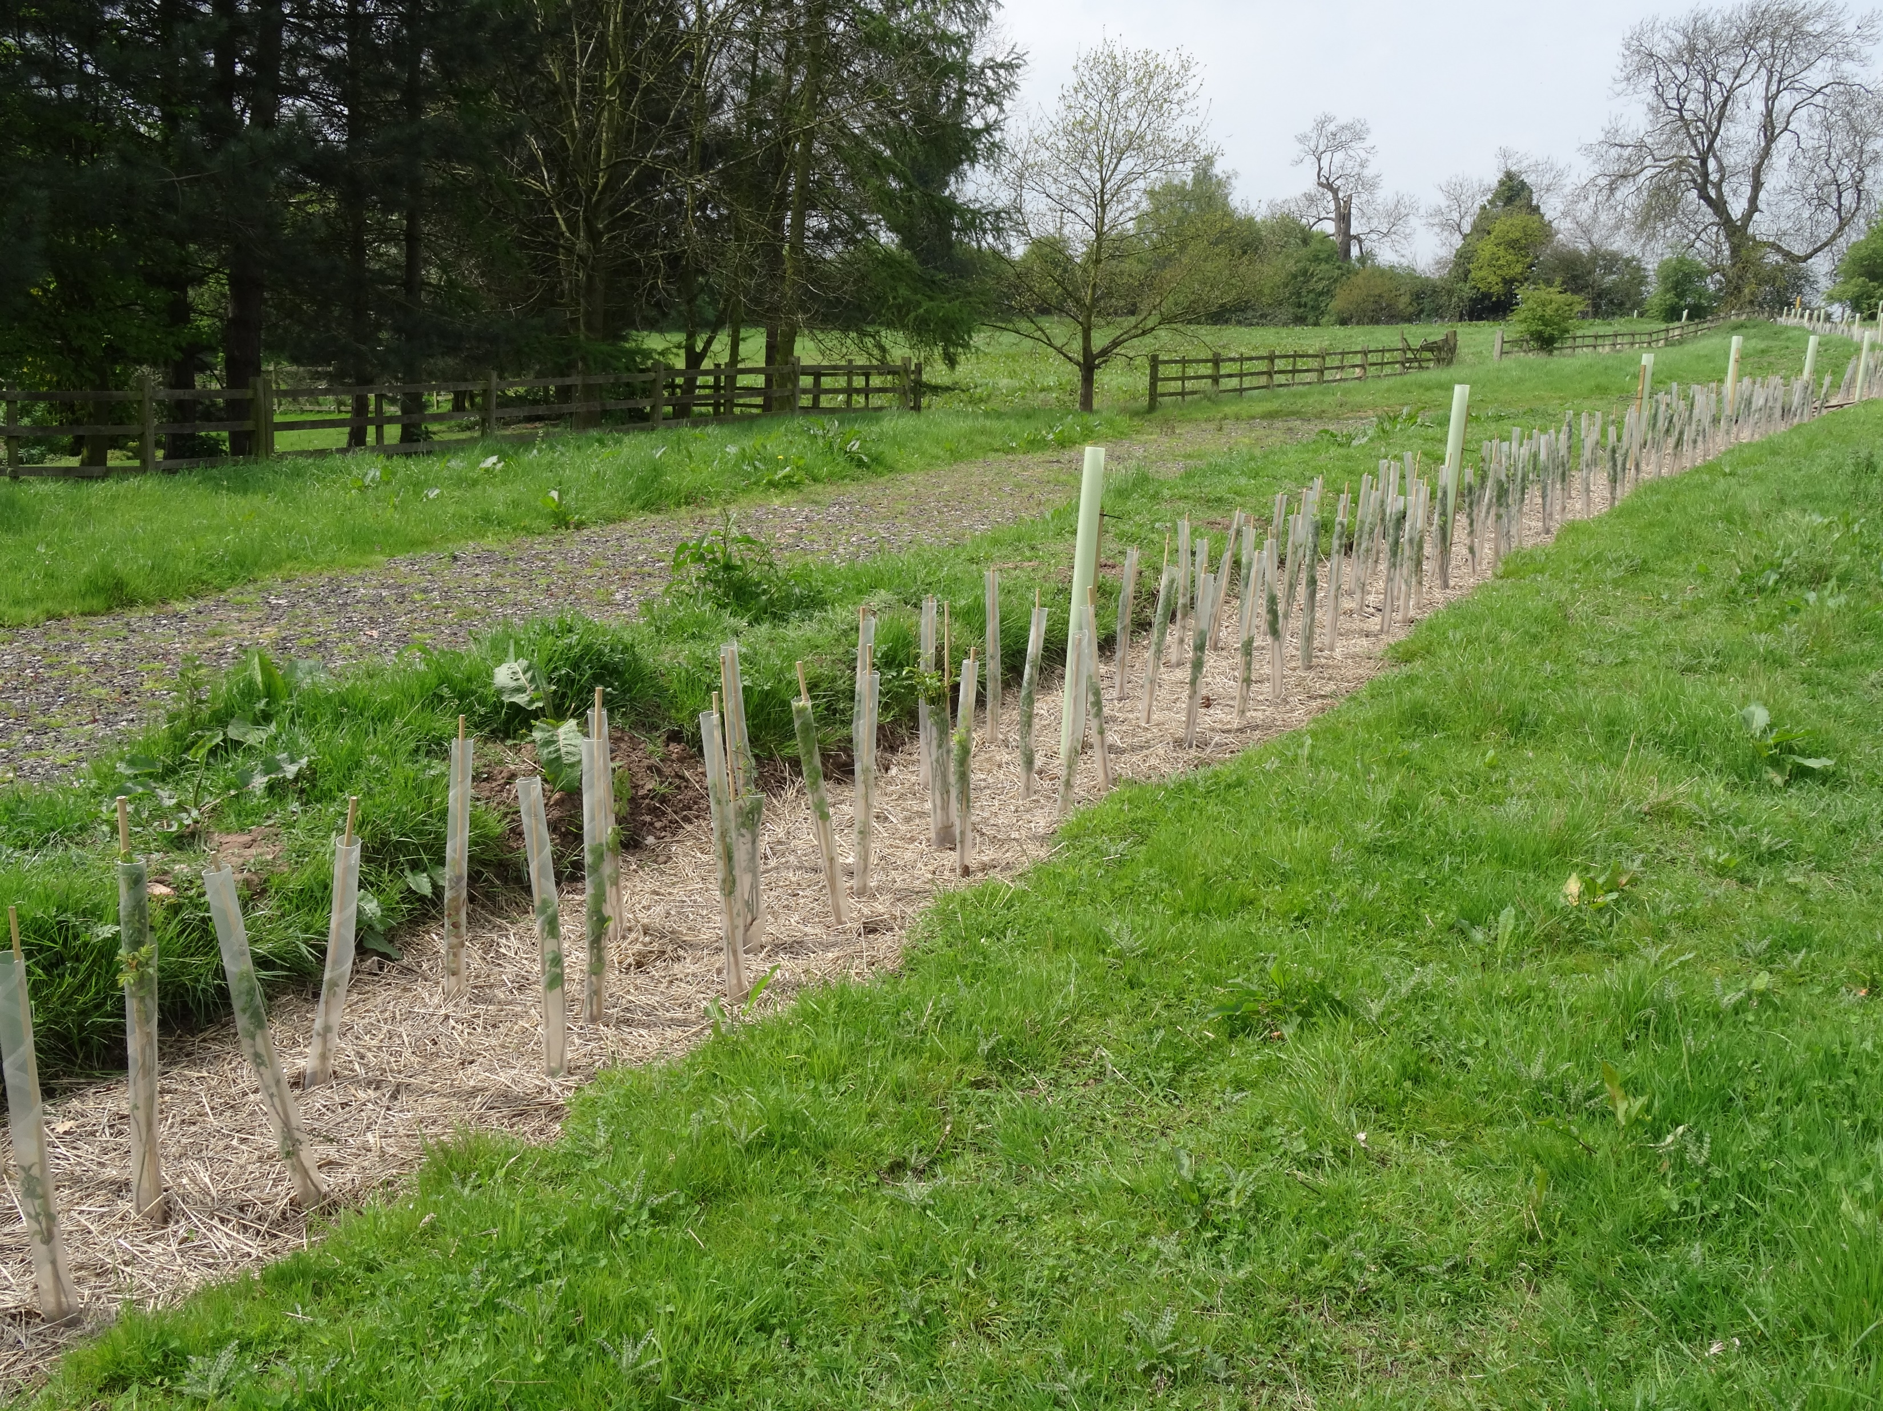
MOREhedges
Notes:
Over 400,000m hedgerow created since 2012

Slide 19
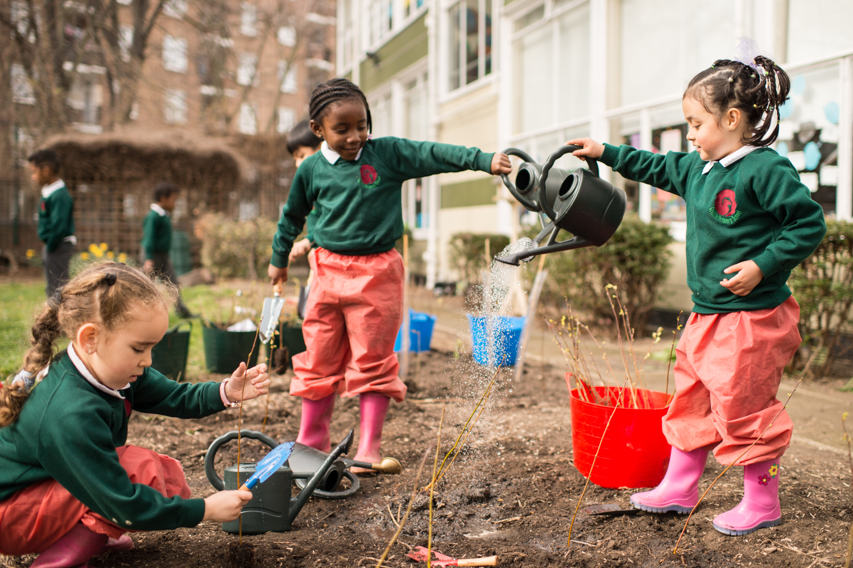
School and community tree packs
Notes:
Planted 12.5m trees since 2012, 44,000 community groups and over 100,000 schools
In 21/22 we sent out 1.1m trees to over 3,000 community groups and 3,876 schools.

Slide 20
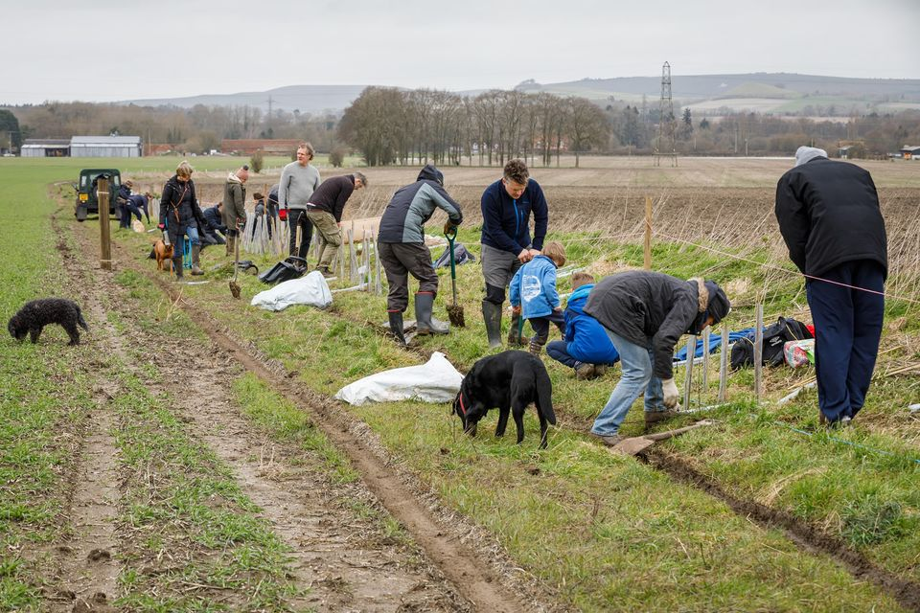
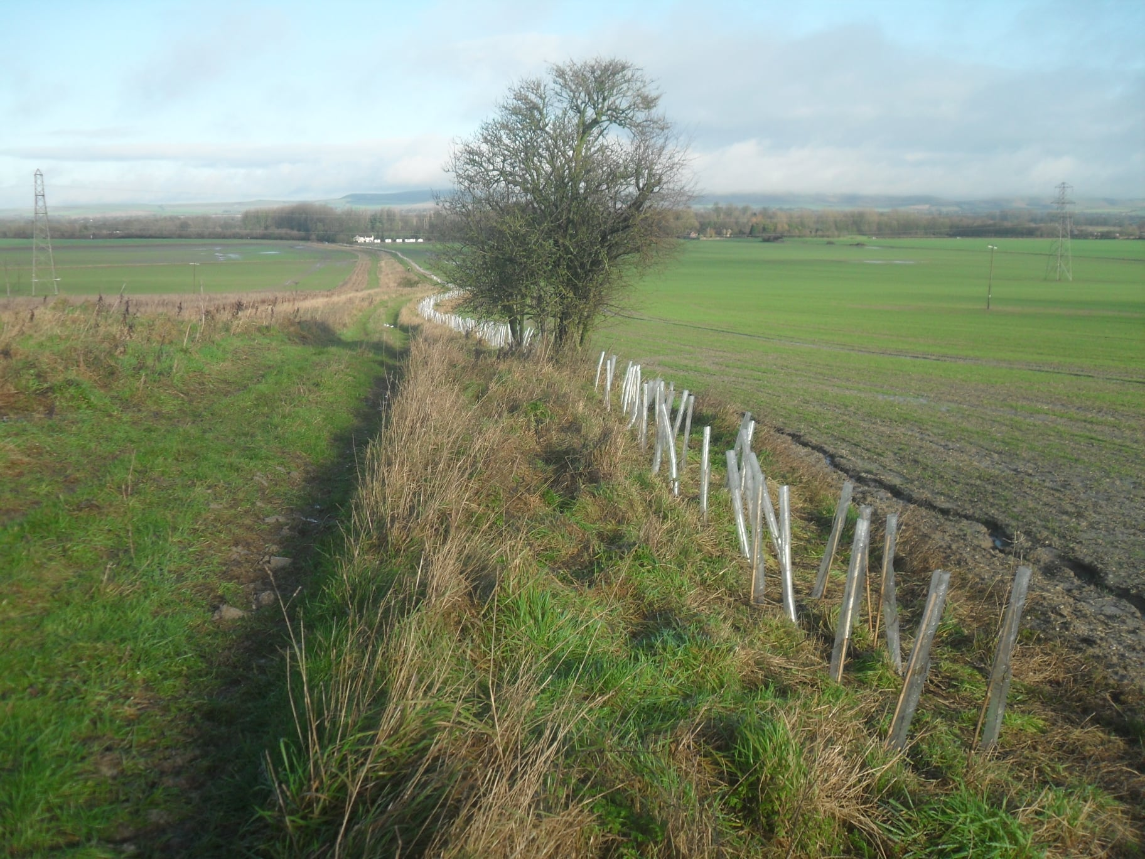
Local initiatives- Vale of Pewsey
Plant for your life

Slide 21
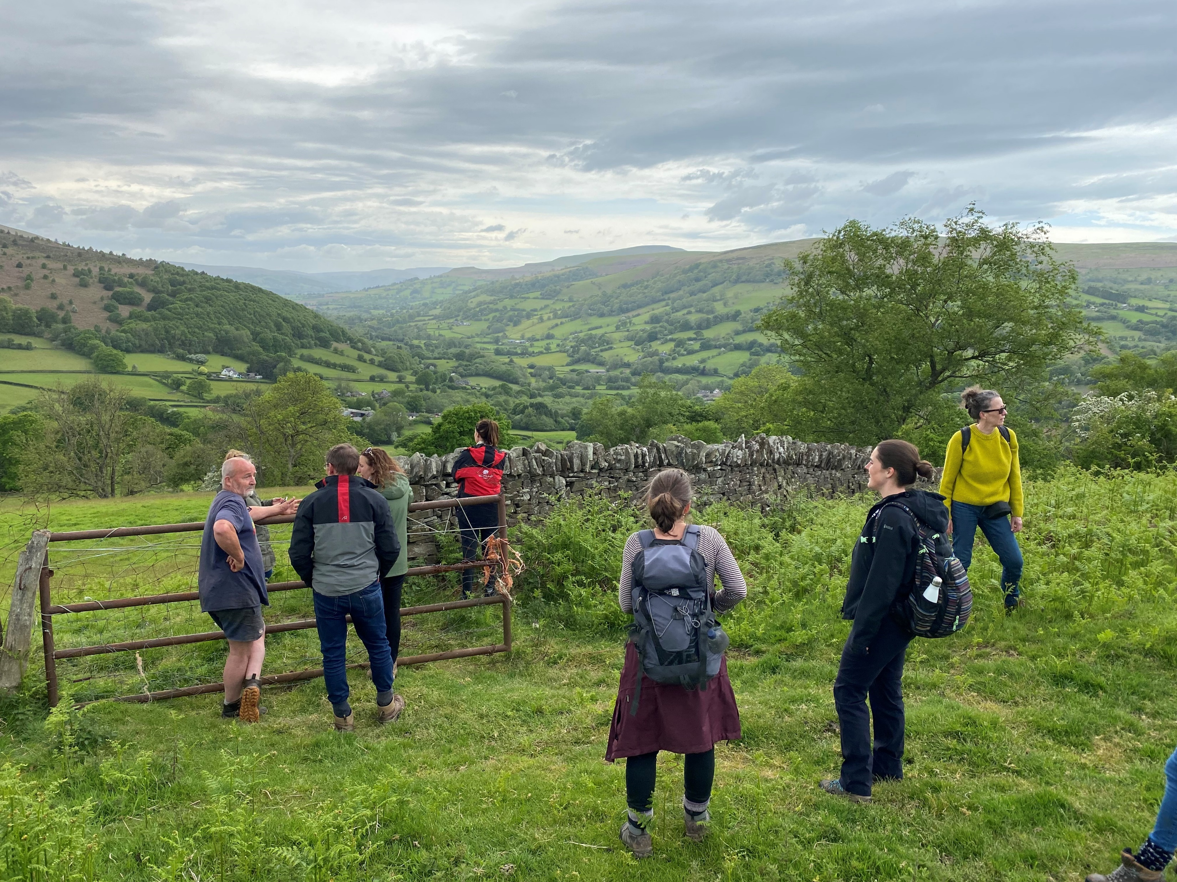
Stump up for trees

Slide 22
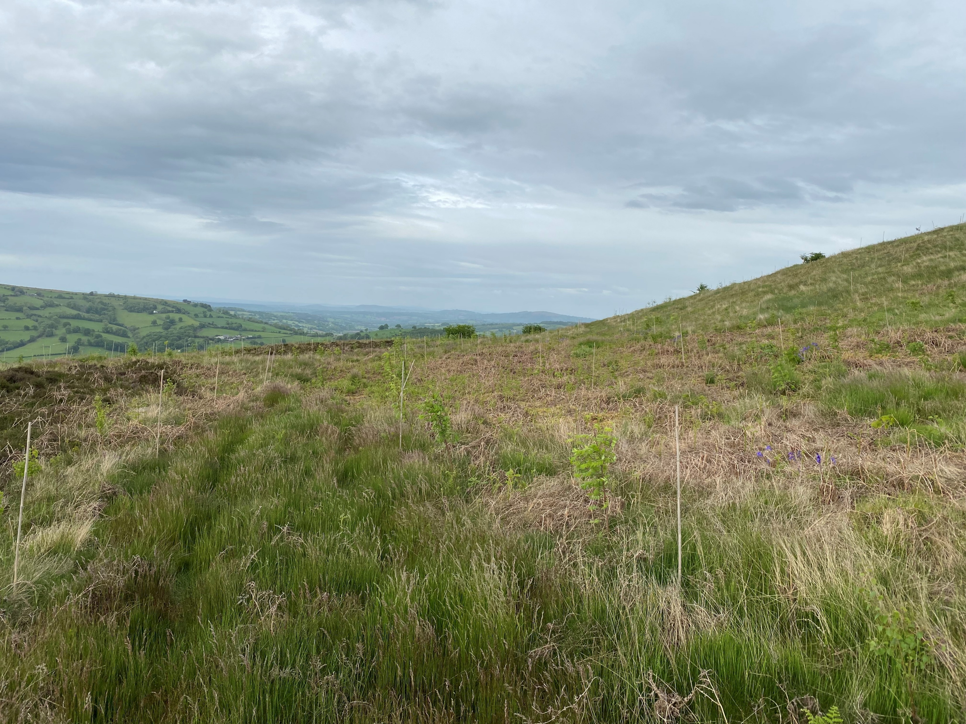

Slide 23
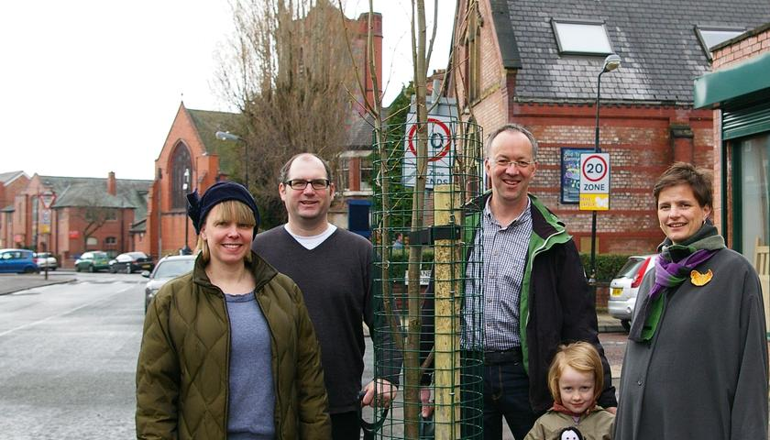
Street tree initiatives

Slide 24
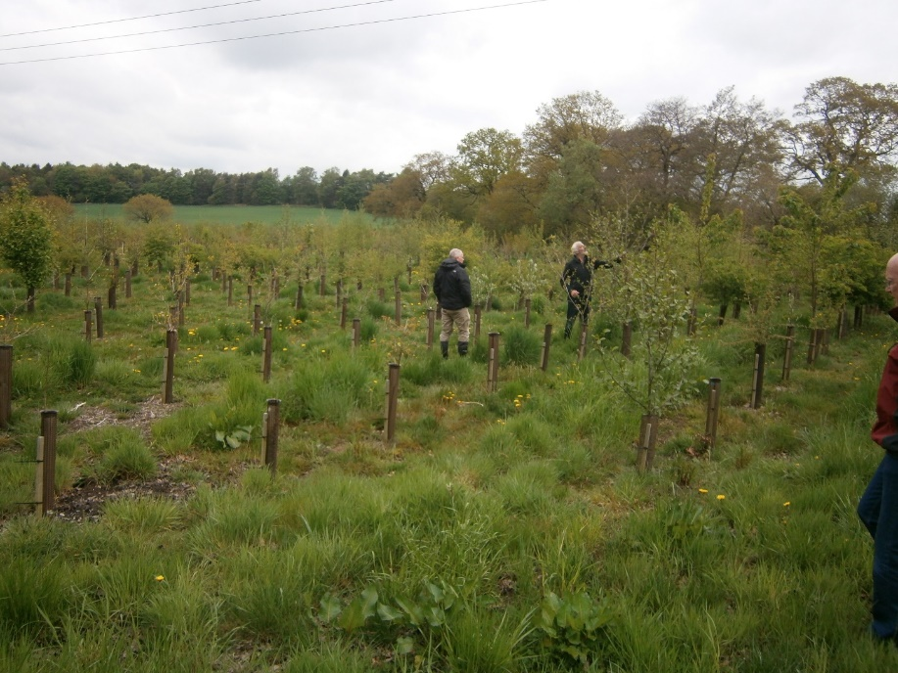
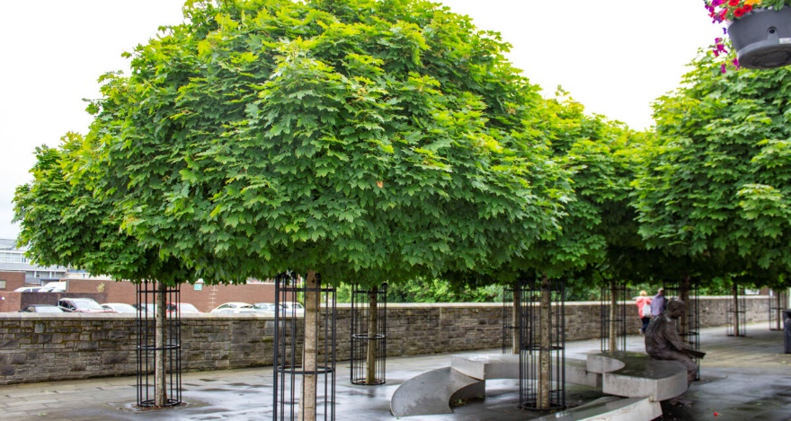
Plan well and plant well.
Ranton estate, Midlands
Bridgend, courtesy of GreenBlue Urban Ltd.

Slide 25
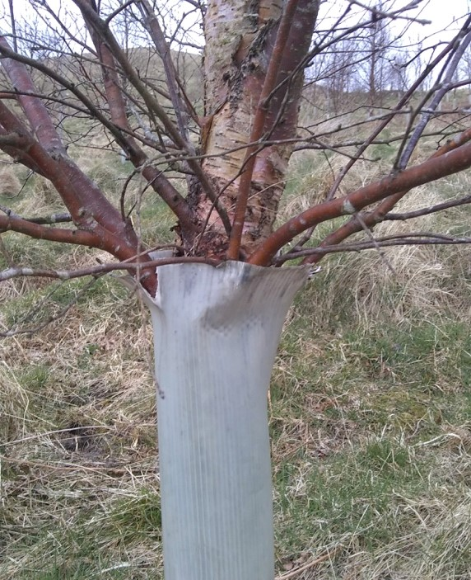
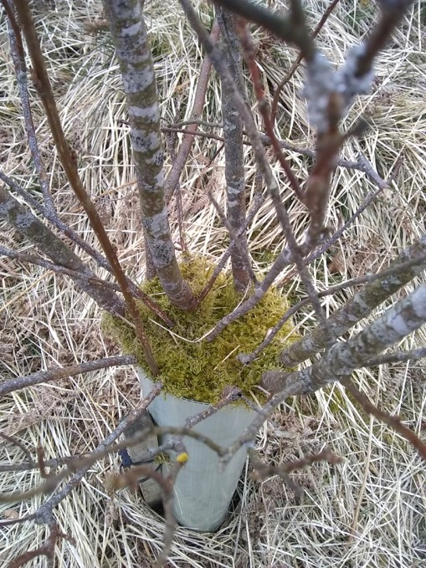
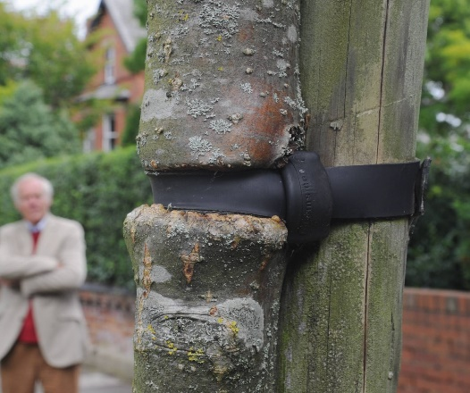
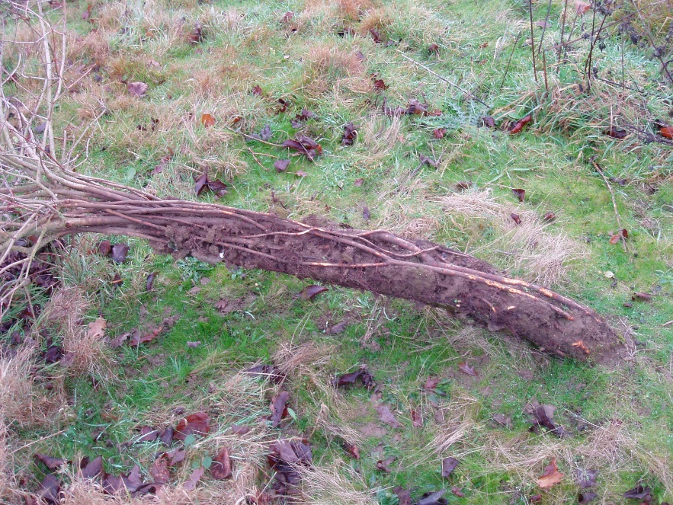
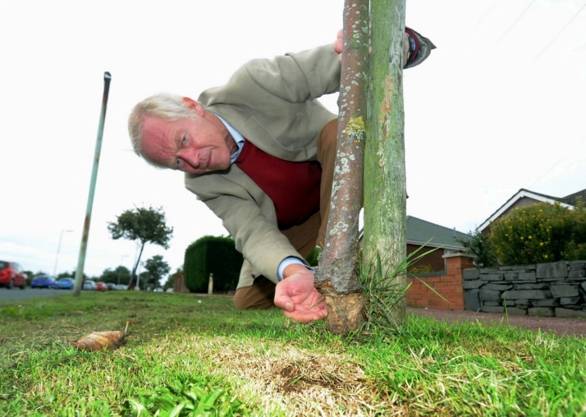
Good maintenance and long term management are essential if you want to achieve your objectives

Slide 26
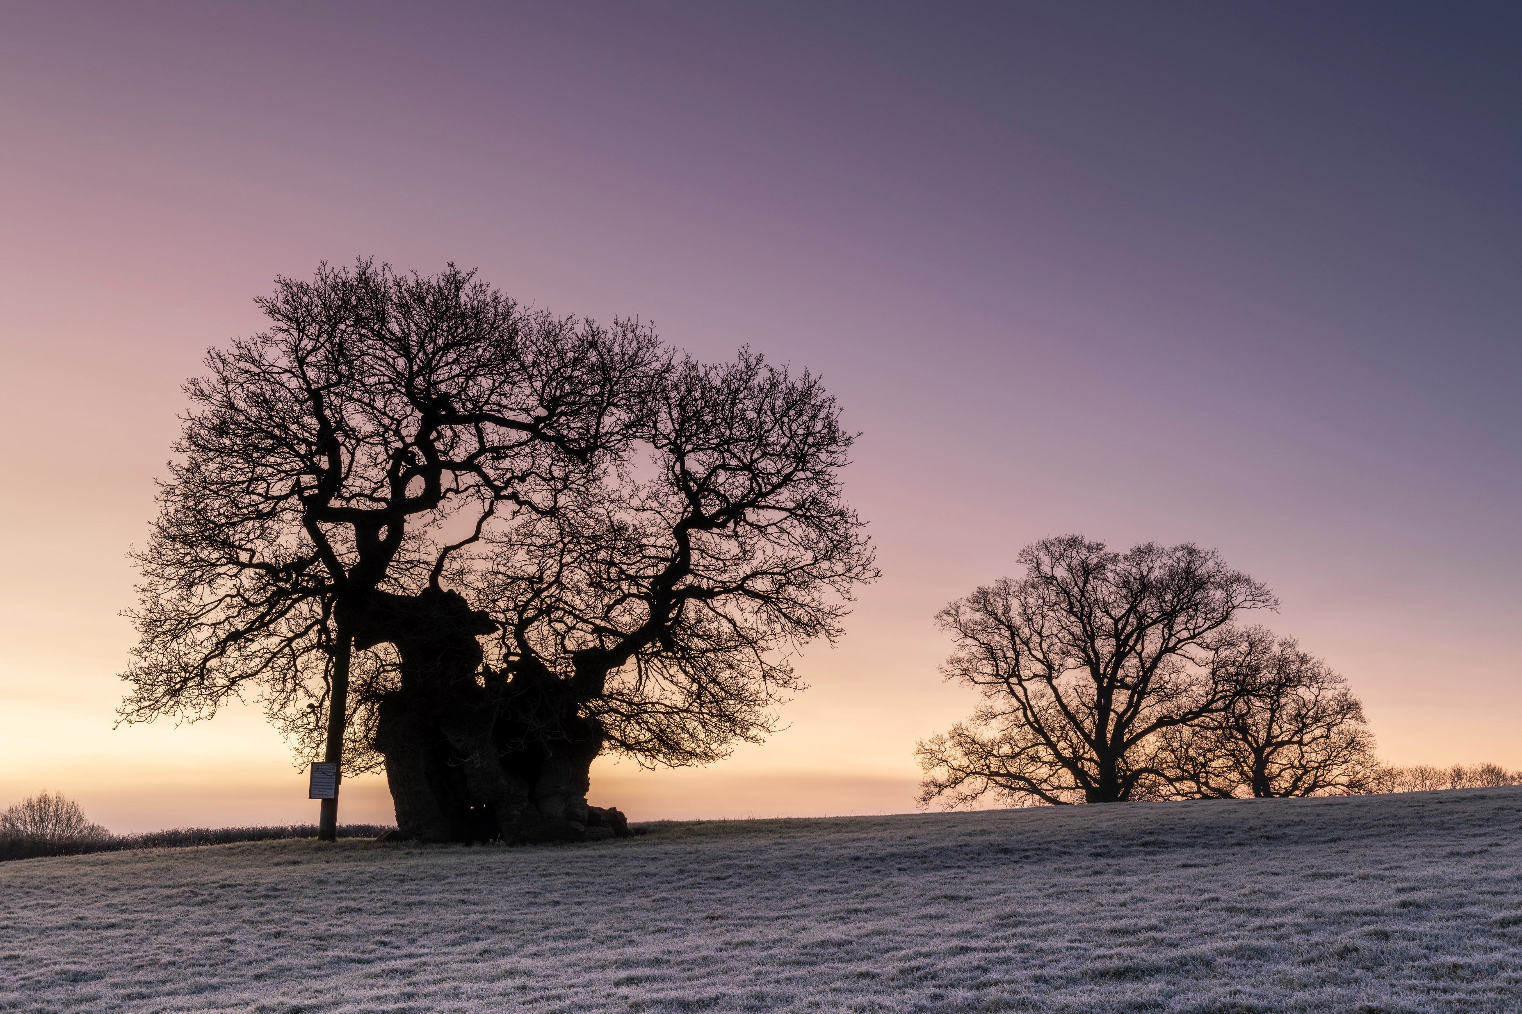
Thank you!

